Slide 1
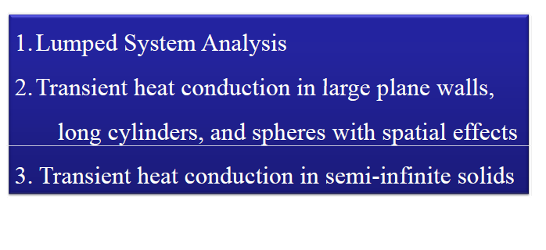
Transient heat conduction

Slide 2
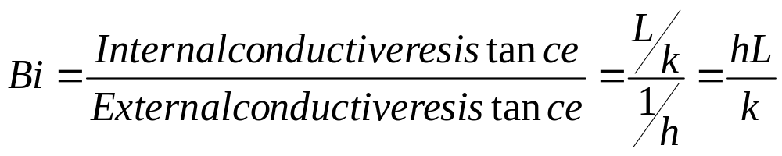
Application of transient problems
Cooling in injection molding of thermoplastics
Cooling of I.C.Engines
Heat treatment of metals
Casting
Bringing processing equipment to steady state

Slide 3
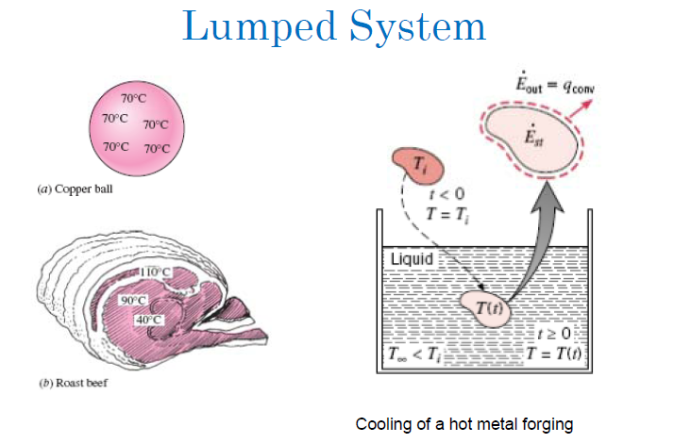

Slide 4
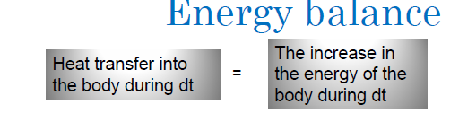
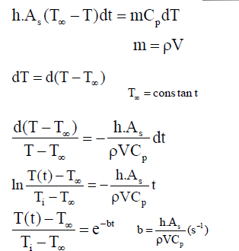
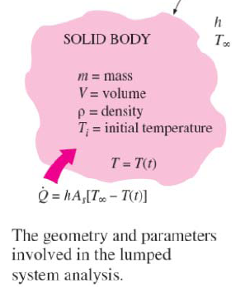

Slide 5
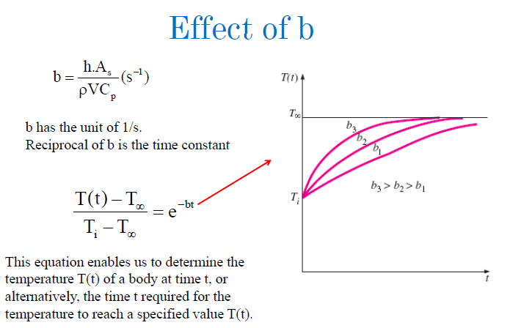

Slide 6
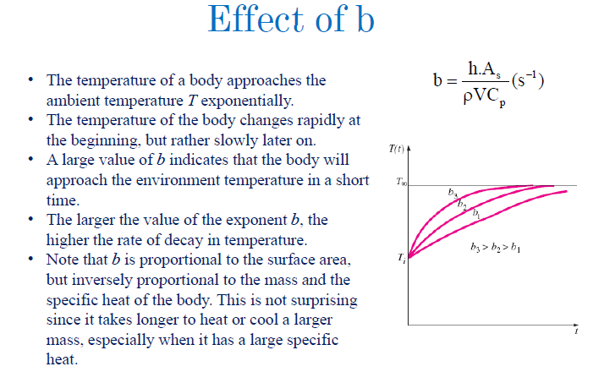

Slide 7
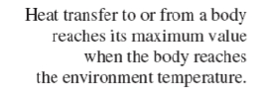

Slide 8
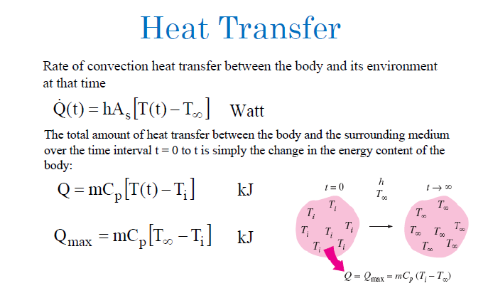

Slide 9
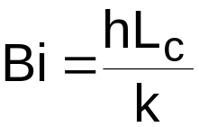
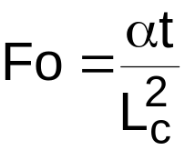
T(x,0) = Ti
T(x,0) = Ti
T(x,0) = Ti
t
t
t
T ∞
T ∞
Bi << 1
T ≈ T(t)
R_{cond} << R_{conv}
Bi ≈ 1
T = T(x,t)
R_{cond} ≈ R_{conv}
Bi >> 1
T = T(x,t)
R_{cond} >> R_{conv}
Definitions:
Biot Number (Bi) = Resistance due to conduction
        Resistance due to convection
Fourier Number (Fo) = dimensionless time
where L_{c} = characteristic length, α = thermal diffusivity, t = time, h = convective heat transfer coefficient, k = thermal conductivity

Slide 10

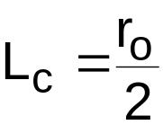
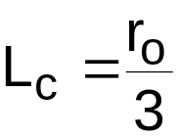
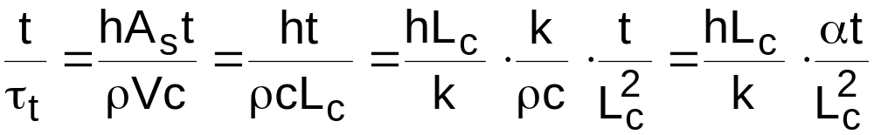
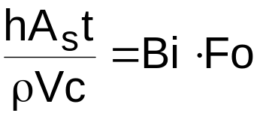
L_{c} = characteristic length = Volume of Solid = V
Total surface Area A_{s}
When Using L.C.M
Time constant
For a plane wall of thickness = 2L
For a Long Cylinder
For a sphere
or

Slide 11
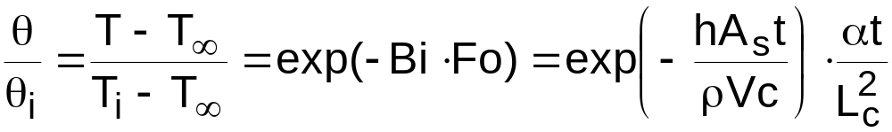
Conclusion
LCM solutions for transient temperature response of a solid (1-D):
Note:
No material in nature have an infinite thermal conductivity.
Many transient heat flow problems can be readily solved by assuming that the internal conductive resistance of the system is very small and the temperature within the system at any instant is uniform.
This is justified when the external thermal resistance between the surface of the system and the surrounding fluid is so large compared to the internal thermal resistance.
To be used only when Bi ≤ 0.1

Slide 12
A 50cm X 50cm copper slab 6.25 mm thick has a uniform temperature of 300ºC. Its temperature is suddenly lowered to 36ºC. Calculate (a) the time required for the plate to reach the temperature of 108ºC. (b) Temperature after 1 min (c) Total heat flow upto 108ºC. (d) instantaneous heat flow at 108ºC. Take h= 90 W/m²K.
A solid copper sphere of 10 cm dia, initially at a temperature of 250ºC, is suddenly immersed in fluid which is maintained at a temperature of 50ºC. If the heat transfer co-efficient between the sphere and the fluid is h=200 W/m²K. Determine the temperature of the copper block at t= 5min after the immersion.
A cylindrical ingot 10 cm in dia and 30 cm long made of steel passes through a heat tratment furnace which is 6m in length. The ingot must reach a temperature of 800ºC before it comes out of the furnace. The furnace gas is at 1250ºC and ingot initial temperature is 90ºC. What is the time required to reach temperature of 800ºC. Take h= 100 W/m²K
An average heat transfer co-efficient for flow of 90ºC air over a flat plate is measured by observing the time history of a 40 mm thick copper slab exposed to 90º C air. In one test run the initial temperature of the plate was 200ºC, and in 4.5 minutes the temperature decreased by 35ºC. Find the heat transfer co-efficient for this case. State the assumptions.

Slide 13
5.The heat transfer co-efficients for the flow of air at 28ºC over a 12.5 mm dia sphere are measured by observing the temperature time history of a copper ball of the same dimension. The temperature of the copper ball was measured by 2 thermocouples, one located at the centre and the other near the surface. Both the thermocuples registered the same temperature at a given instant. In one test the initial temperature of the ball was 65º C and in 1.15 minutes the temperature decreased by 11ºC. Calculate the heat transfer co-efficient for this case. State the assumptions.

Slide 14
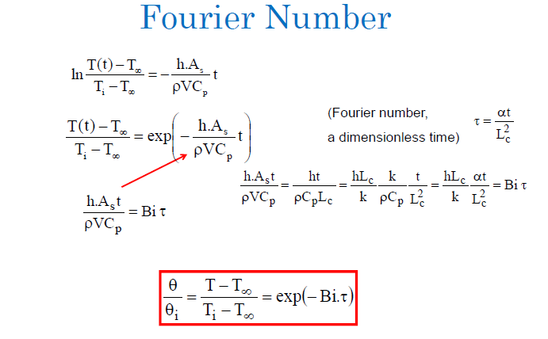

Slide 15
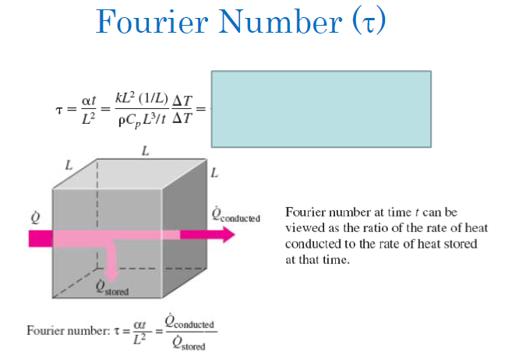

Slide 16
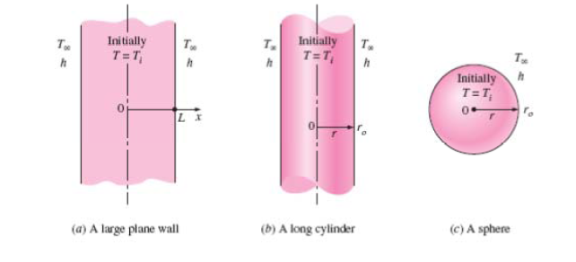

Slide 17
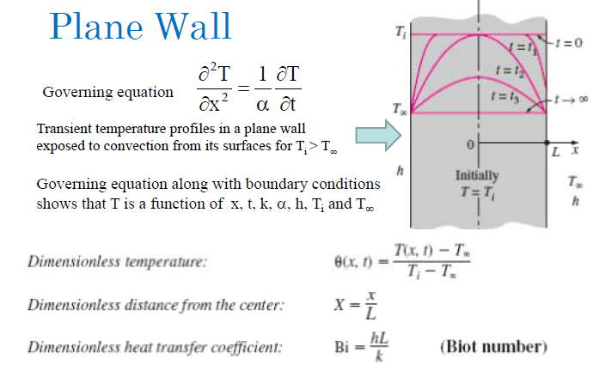


Slide 18
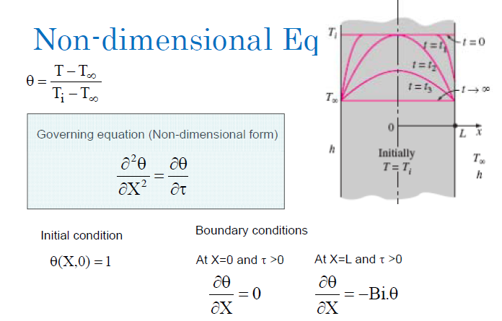

Slide 19
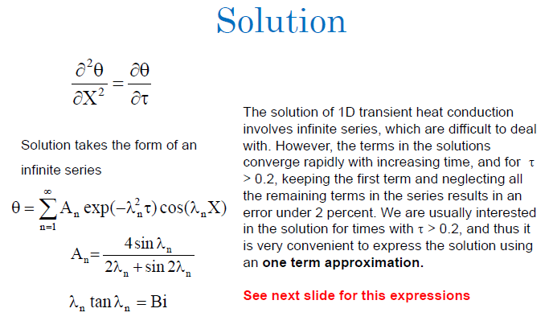

Slide 20
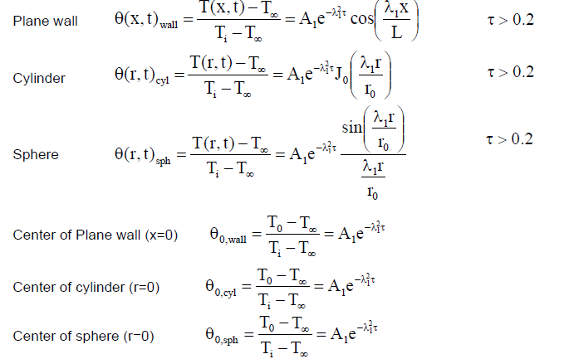

Slide 21
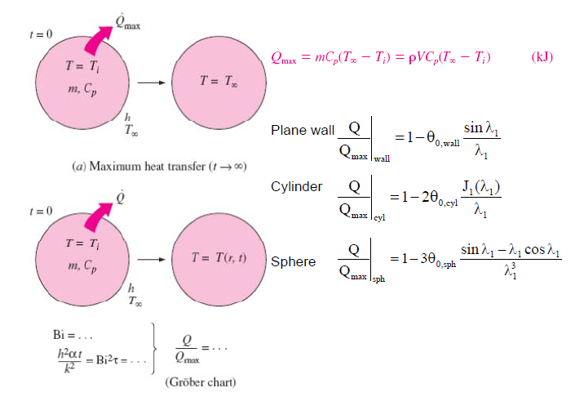

Slide 22
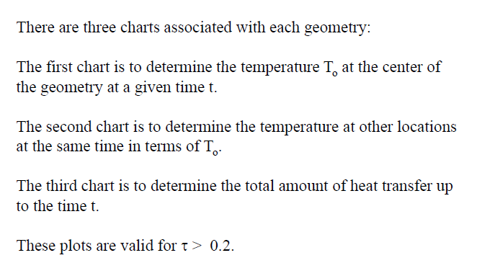

Slide 23
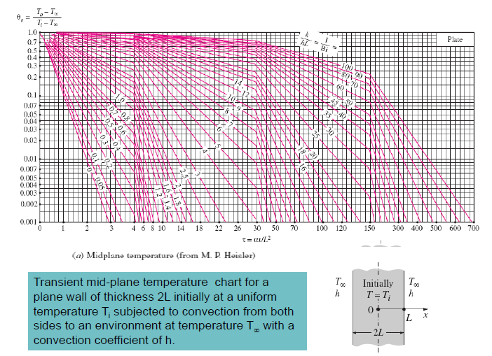

Slide 24
1. A 60 mm thick large steel plate initially at 440ºC is suddenly exposed on both sides to an environment With convective heat transfer co-efficient 235W/m²K and temperature 50ºC. Determine the centerline temperature, and temperature inside the plate 15mm away from the midplane after 4.3 minutes. Also calculate the total heat energy removed per unit area of the plate during the period.
2. A long cylindrical bar (k= 17.4 W/m K, thermal diffusivity = 0.019 m²/h) of radius 80mm comes out of oven at 830ºC throughout and suddenly cooled by quenching it in a large bath of 40º C coolant. The surface co-efficient of heat transfer between the bar surface and the given coolant is 180W/m²K. Determine the time taken by the shaft to reach 120ºC. Also determine the surface temperature when the centre temperature is 120ºC.
3. A metallic sphere of radius 10 mm is initially at a uniform temperature of 400ºC. It is heat treated by first cooling it in air with (h= 10 W/m²K) at 20ºC until its central temperature reaches 335ºC. It is then quenched in a water bath at 20ºC with h= 6000 W/m²K until the sphere cools from 335ºC to 50ºC. Calculate the time required for cooling in water and cooling in air. Also find the surface temperature at the end of water cooling. Take density= 3000 kg/m3. Specific heat = 1000 J/kgK. Thermal conductivity = 20 W/mK, Thermal diffusivity = 6.66 x 10⁻⁶ m²/s.

Slide 25
Infinite Solid and semi infinite Solid
INFINITE SOLID: A Solid extends itself infinitely in all directions of space is termed as an Infinite solid.
SEMI INFINITE SOLID : If an infinite solid is split in the middle by a plane, each half is known as semi infinite solid.
In a semi infinite body at any instant of time, there is always a point where the effect of heating or cooling at one of its boundaries is not felt at all. At that point the temperature remains unaltered.
The boundary conditions are
(i) T(x,0) = T_{i}
(ii) T(0,t) = T_{s}, For t greater than zero.
(iii) T(∞,t)= T_{i}

Slide 26
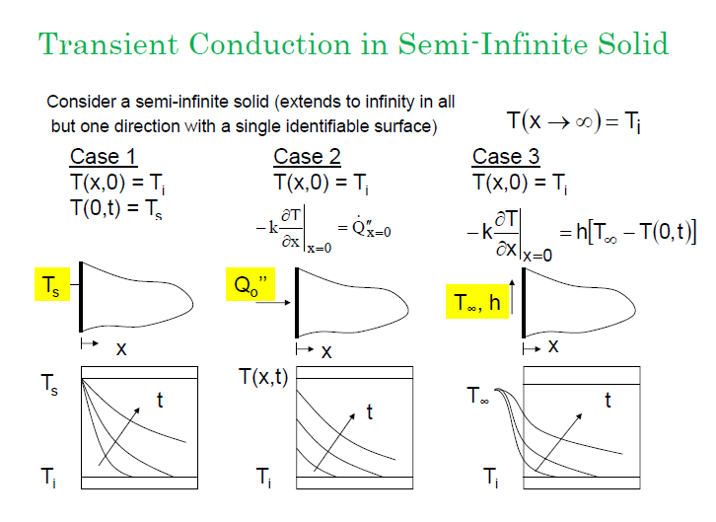

Slide 27
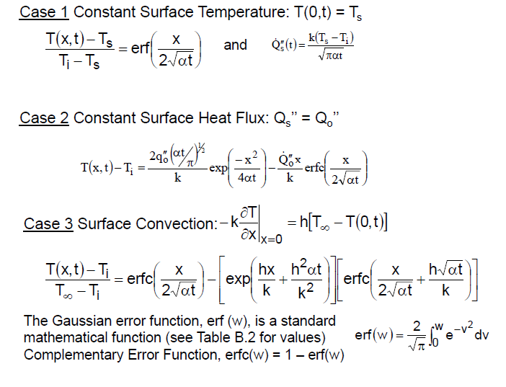

Slide 28
A large steel ingot heated uniformly to 745ºC is hardened by quenching it in an oil bath maintained at 20ºC. Determine the length of time required for the temperature to reach 595ºC at a depth of 12mm. Take thermal diffusivity = 1.2 x 10⁻⁵ m²/s.
It is proposed to bury water pipes underground in wet soil which is initially at 4.5ºC. The temperature of the surface of soil suddenly drops to -5ºC and remains at this value for 10 hours. Determine the minimum depth at which the pipes be laid if the surrounding soil temperature is to remain above 0ºC. Assume the soil to be semi inifinite solid. Take thermal diffusivity of soil = 2.78 x 10⁻³ m²/h.

